Slide 1
PLANT DISEASE DETECTION APPLICATION FOR FARMERS

Slide 2
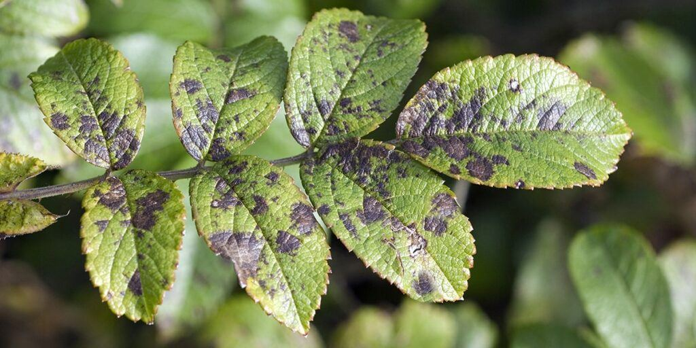
PROBLEM STATEMENT
Challenge: Farmers often struggle to identify and manage plant diseases effectively, leading to reduced crop yield and financial losses.
Need: There is a need for a convenient and accurate solution to help farmers detect and diagnose plant diseases early on.

Slide 3
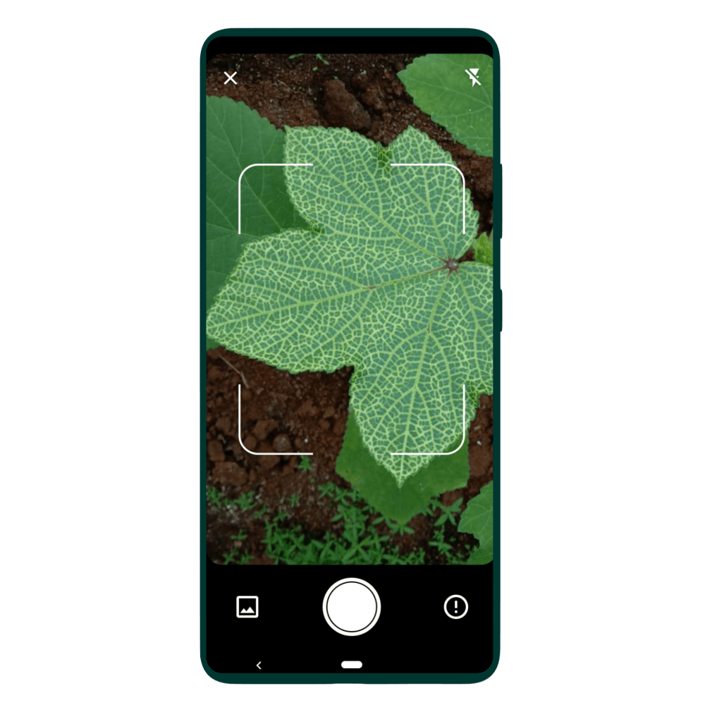
SOLUTION
Plant Disease Detection App: Our app utilizes OpenCV technology to analyze images of plant leaves and accurately identify diseases.
Key Features: - Image upload functionality for leaf analysis. - Real-time disease detection using computer vision algorithms. - Detailed disease diagnosis and treatment recommendations.

Slide 4
MARKET OPPORTUNITY
Target Market: Small to medium-scale farmers, agricultural cooperatives, and plantation owners.
Market Size: Include statistics or estimates on the size and growth of the agricultural industry in your target region.
Competitive Landscape: Overview of existing solutions and their limitations.

Slide 5
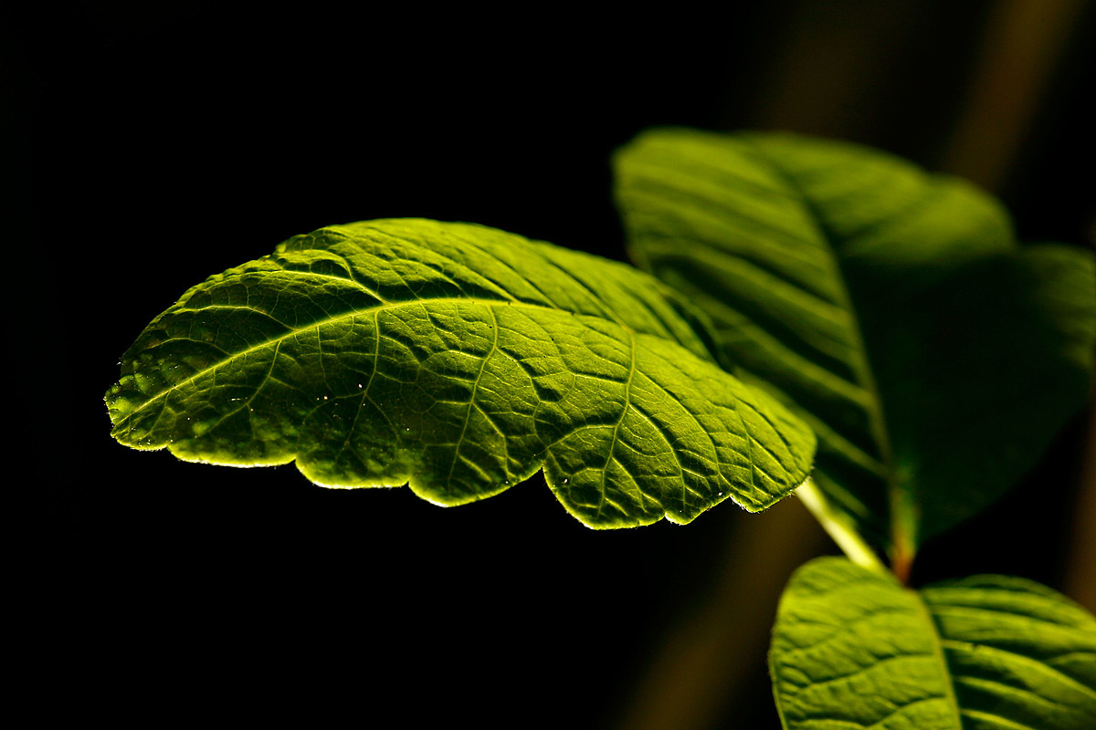
METHODOLOGY
Train a model on various plant diseases and also train the model to identify heathy plants for the desired application.
Use Open CV for Image Processing and Disease Detection.
Use other Artificial Intelligence and Computer Vision related libraries to design the application.

